Slide 1
13. Language model - smoothing IT348/448

Slide 2

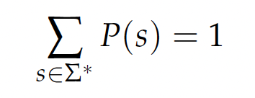

Language Models (LMs)
A language model is a function LANGUAGE MODEL that puts a probability measure over strings drawn from some vocabulary
For a LM M over all alphabet , ,
It means the following:

Slide 3
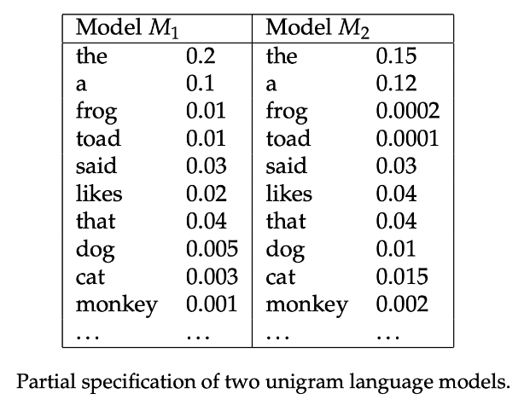
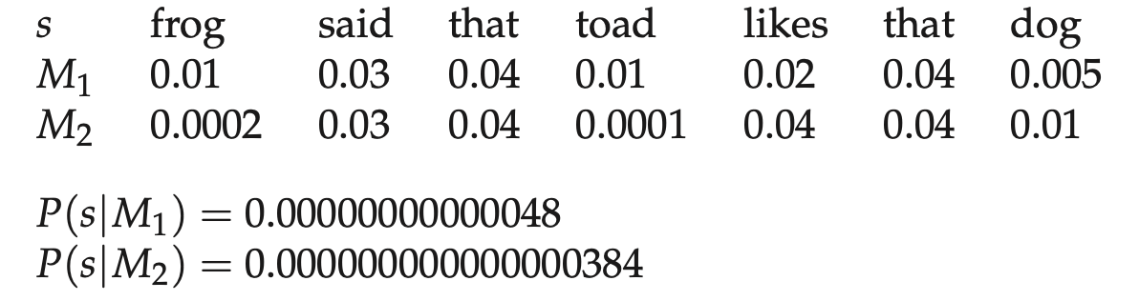
Language Models (LMs): Example
P(s|M₁) > P(s|M₂)

Slide 4

Language Models (LMs)
Basic LM using chain rule:
Unigram language model:
Throws away all conditioning context.
Most used in Information Retrieval.
Bigram language model:
Condition on the previous term.

Slide 5

Query Likelihood Model
Query likelihood model:
Rank document by P(d|q)
Likelihood that document d is relevant to the query.
Using Bayes rule:
P(q) is the same for all documents.
P(d) is treated as uniform across all d.
The general form of Bayes’ rule with normalization:

Slide 6
Query Likelihood Model
Retrieve based on a language model:
Infer a LM for each document.
Estimate P(q|M_{di}).
Rank the documents according to these probabilities.

Slide 7
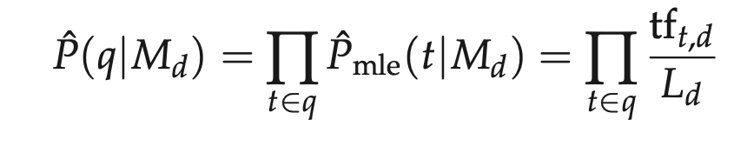
Query Likelihood Model
Estimating the query generation probability:
M_{d} is the language model of document d
Tf_{t,d} is the (raw) term frequency of term t in document d
L_{d} is the number of tokens in document d
Smoothing:
Use the whole collection to smooth.
Linear Interpolation (Jelinek-Mercer Smoothing)

Slide 8
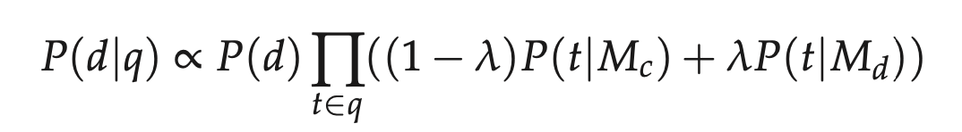
Query Likelihood Model
Query likelihood model with linear interpolation:
M_{c} is the language model built from the entire document collection.
This mixes the probability from the document with the general collection frequency of the word.
This equation captures the probability that the document that the user had in mind is in fact d.

Slide 9
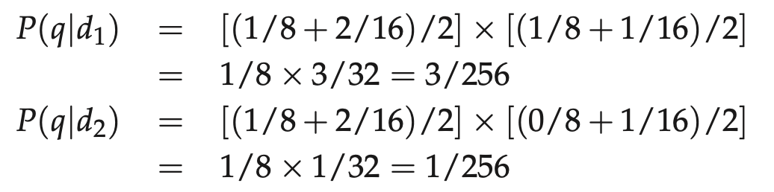
Query Likelihood Model
Example:
d1: Xyzzy reports a profit but revenue is down
d2: Quorus narrows quarter loss but revenue decreases further
λ=1/2
Corpus (i.e., document collection) = d1 + d2 number of terms in the corpus = 16
query: revenue down
ranking: d1 > d2

Slide 10
Application
Community-based Question Answering (CQA) System:
Question Search.
Given a queried question, find a semantically equivalent question for the queried question.
General Search Engine
Given a query, rank documents.

Slide 11
Language Models
N-gram models
Is a sequence of N words
Special cases
1-gram = unigram
2-gram = bigram
3-gram = trigram

Slide 12
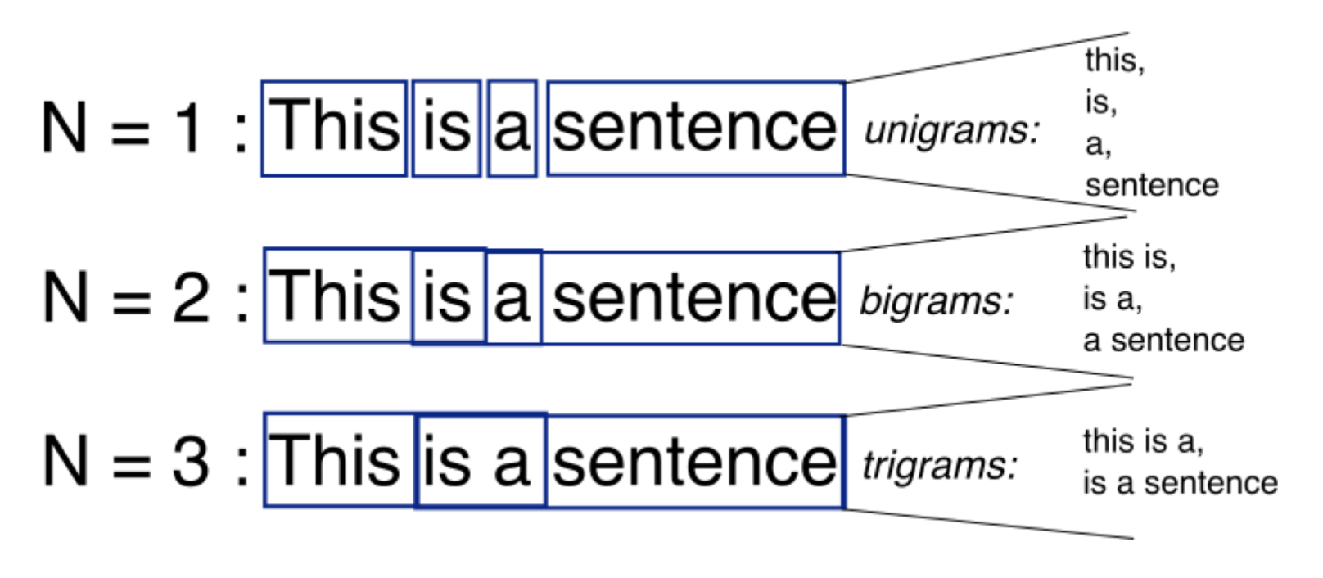
N-grams
N-grams: a continuous sequence of n tokens

